Slide 1
Ben’s Pizzeria

Slide 2


Abstract
A
Ben’s Pizzeria aims to address this need by developing a comprehensive database system tailored specifically for pizzerias.
The database schema is meticulously crafted to capture essential entities such as customers, menu items, orders, and deliveries, while establishing robust relationships between these entities to ensure data integrity and consistency.

Slide 3
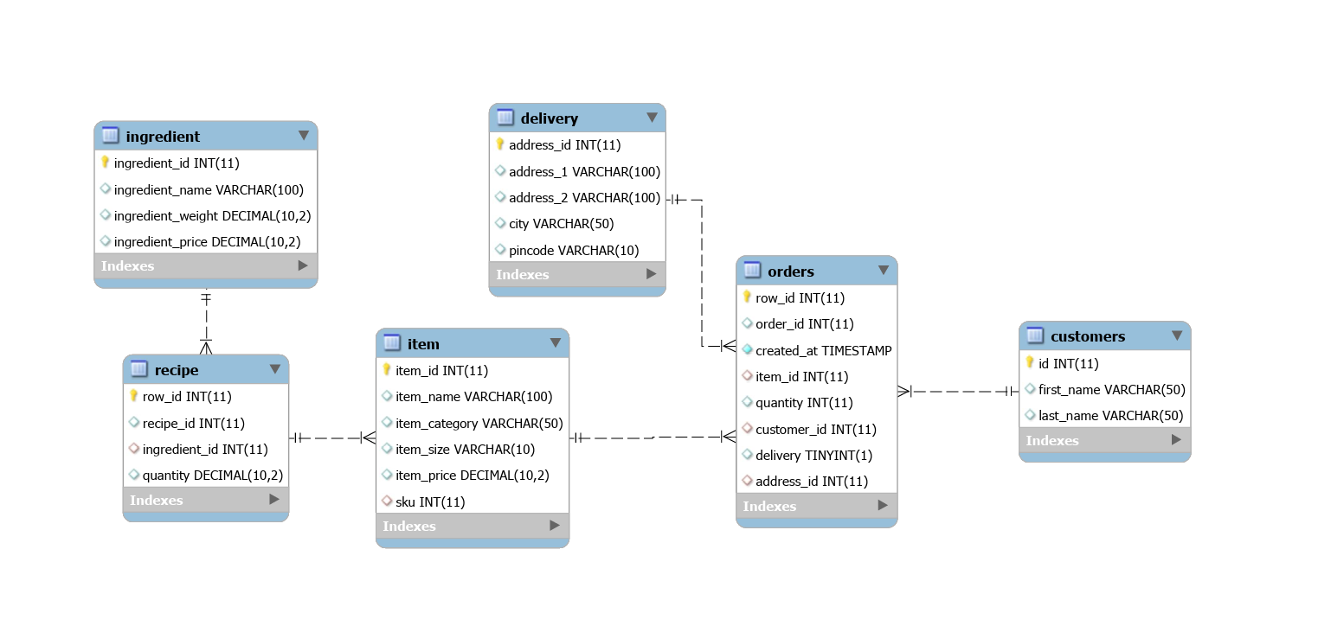
ER Diagram

Slide 4
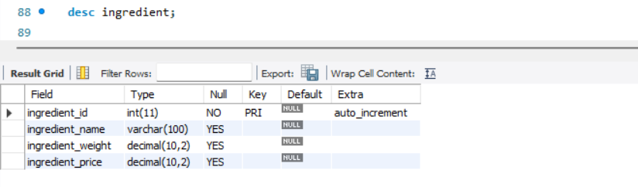
Structure Of Table
Ingredients Table
This table shows the ingredient name, id, weight and its price details.
Syntax: DESC ingredient;

Slide 5
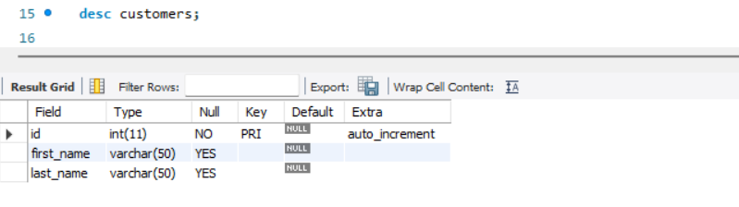
Structure Of Table
Customers Table
This table shows the customer details viz. id, first name , last name.
Syntax: DESC customer;

Slide 6
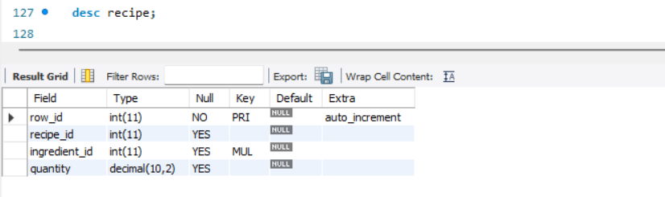
Structure Of Table
Recipe Table
This table shows the recipe id, unique row id , ingredient id and quantity
Syntax: DESC recipe;

Slide 7
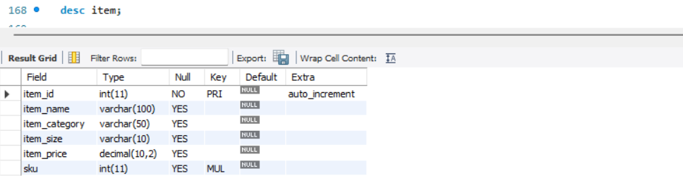
Structure Of Table
Items Table
This table shows the item id, item name, item category, item size, item price.
Syntax: DESC item;

Slide 8
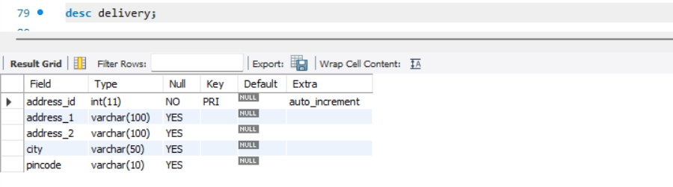
Structure Of Table
Delivery Table
This table shows the address id , address split into 2 parts, city and pin code.
Syntax: DESC delivery;

Slide 9
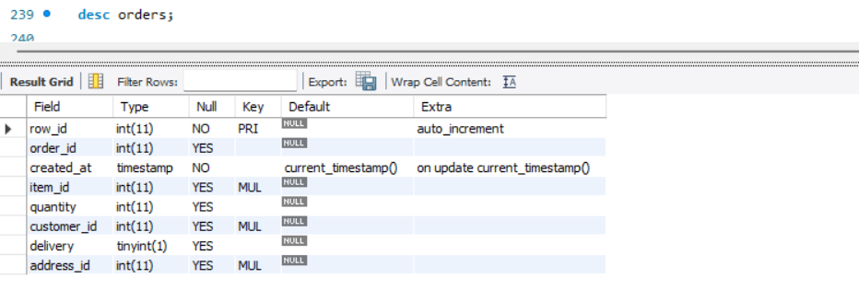
Structure Of Table
Orders Table
This table shows the unique row id for each order quantity, order id, order time, item id, quantity, customer id, delivery, address id.
Syntax: DESC orders;

Slide 10
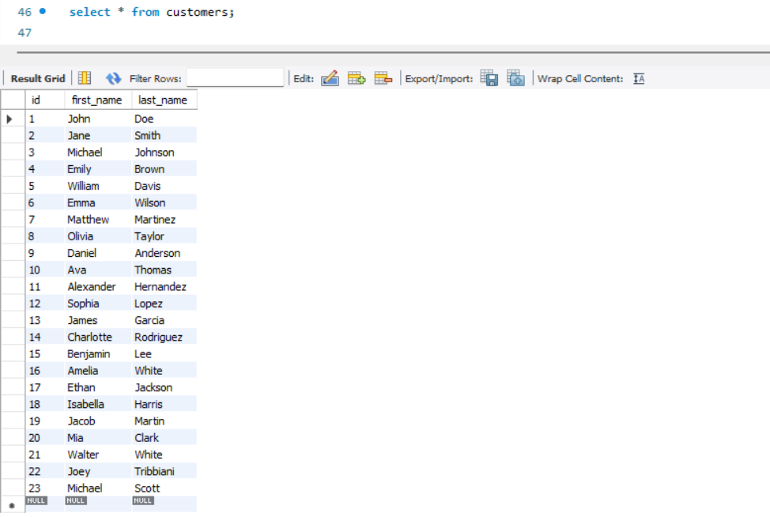
Contents Of Table – Customer Table

Slide 11
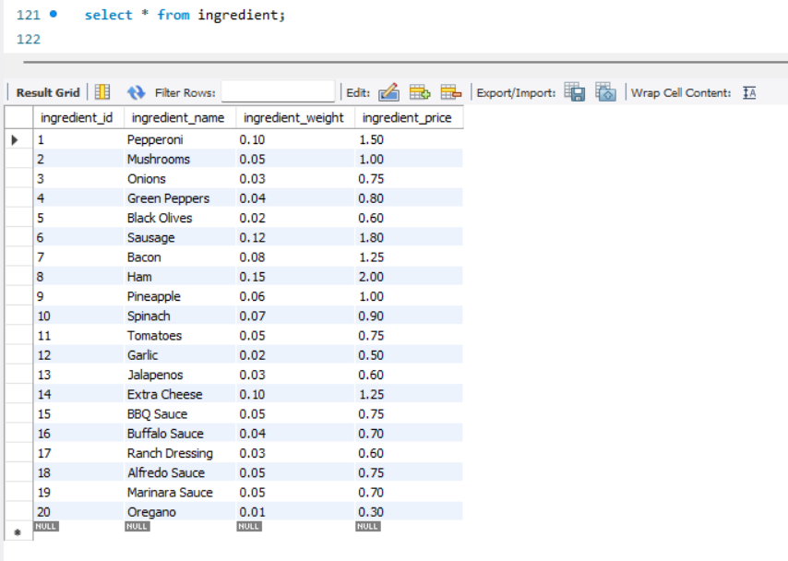
Contents Of Table – Ingredient Table

Slide 12
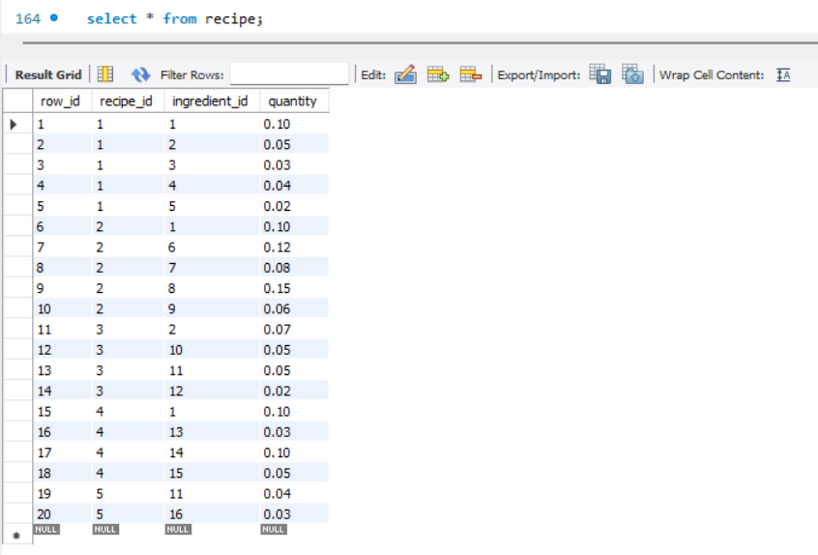
Contents Of Table – Recipe Table

Slide 13
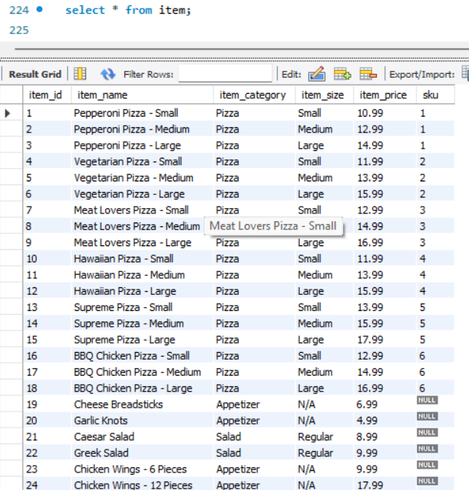
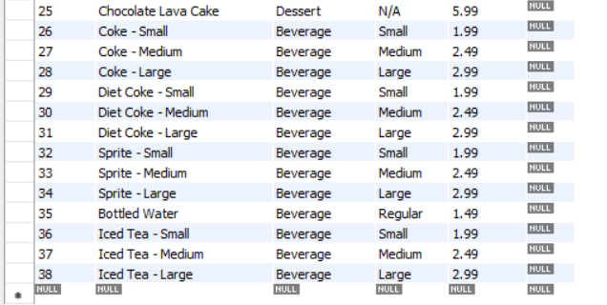
Contents Of Table – Item Table

Slide 14
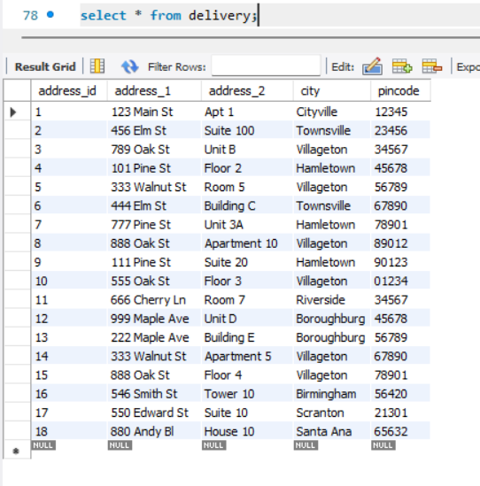
Contents Of Table – Delivery Table

Slide 15
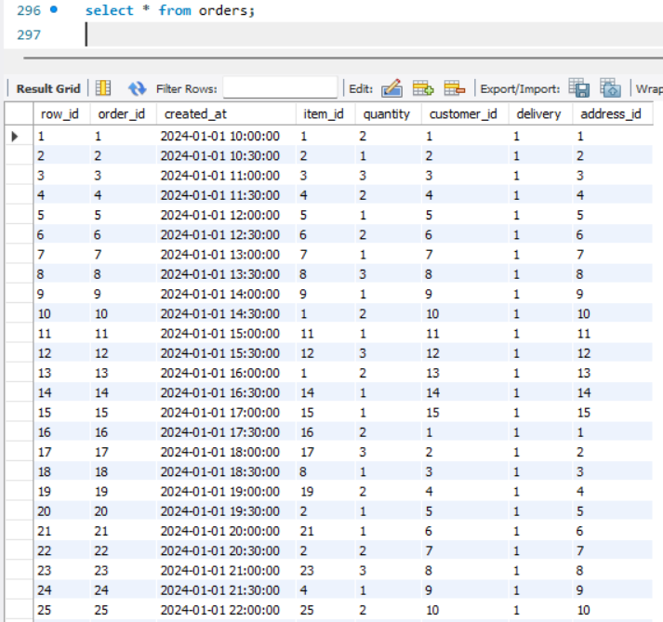
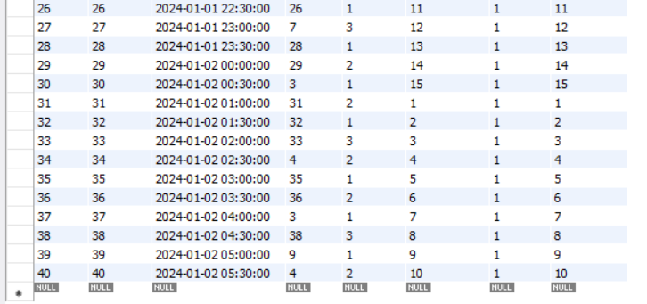
Contents Of Table – Orders Table

Slide 16

SUB QUERIES

Slide 17
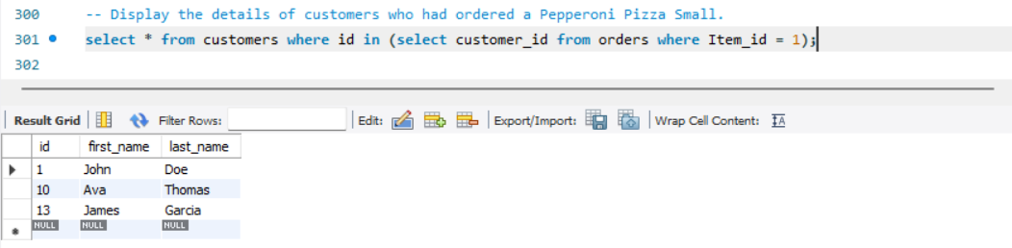
Sub query
Display the details of customers who had ordered a Pepperoni Pizza Small.
Syntax:
select * from customers where id in (select customer_id from orders where Item_id = 1);

Slide 18
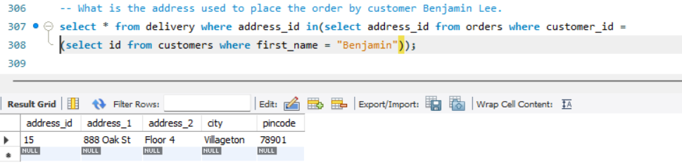
Sub query
What is the address used to place the order by customer Benjamin Lee.
Syntax:
select * from delivery where address_id in(select address_id from orders where customer_id =(select id from customers where first_name = "Benjamin"));

Slide 19
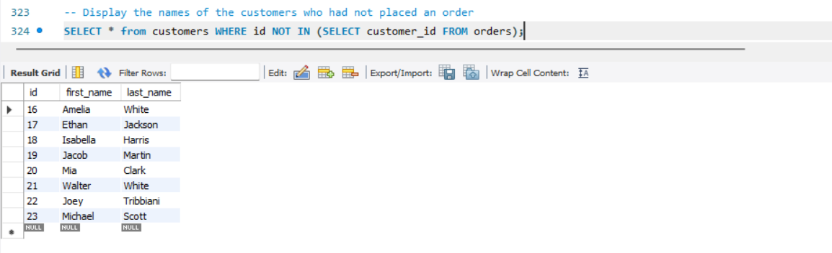
Sub query
Display the names of the customers who had not placed an order.
Syntax:
SELECT * from customers WHERE id NOT IN (SELECT customer_id FROM orders);

Slide 20
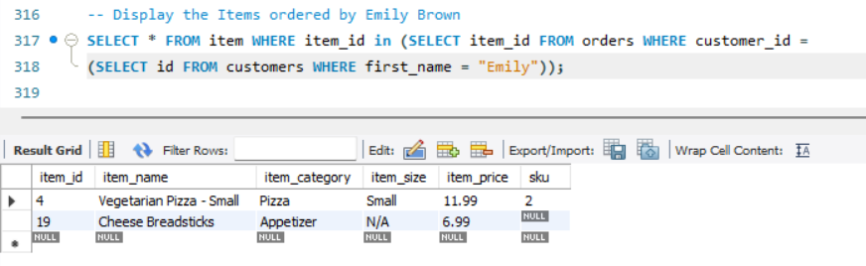
Sub query
Display the Items ordered by Emily Brown.
Syntax:
SELECT * FROM item WHERE item_id in (SELECT item_id FROM orders WHERE customer_id =(SELECT id FROM customers WHERE first_name = "Emily"));

Slide 21
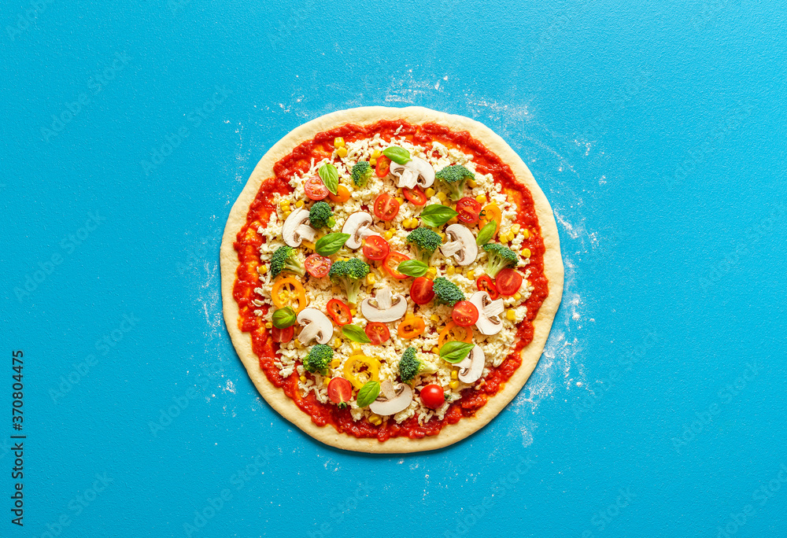
JOINS

Slide 22
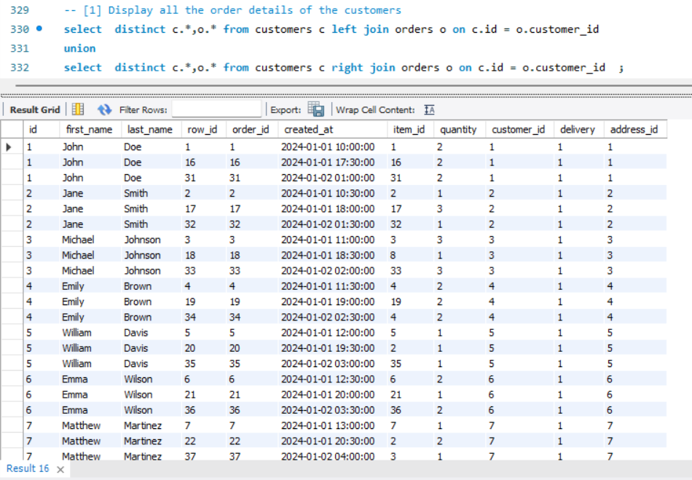
Joins
Display all the order details of the customers.
Syntax:
select distinct c.*,o.* from customers c left join orders o on c.id = o.customer_id union select distinct c.*,o.* from customers c right join orders o on c.id = o.customer_id ;

Slide 23
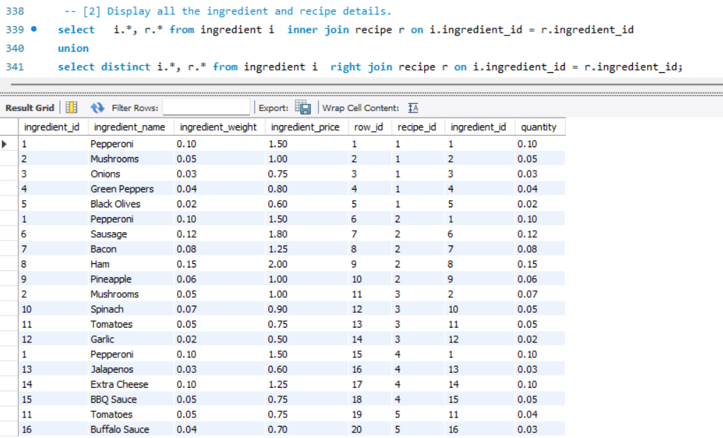
Joins
Display all the ingredient and recipe details.
Syntax:
select i.*, r.* from ingredient i join recipe r on
i.ingredient_id = r.ingredient_id;

Slide 24
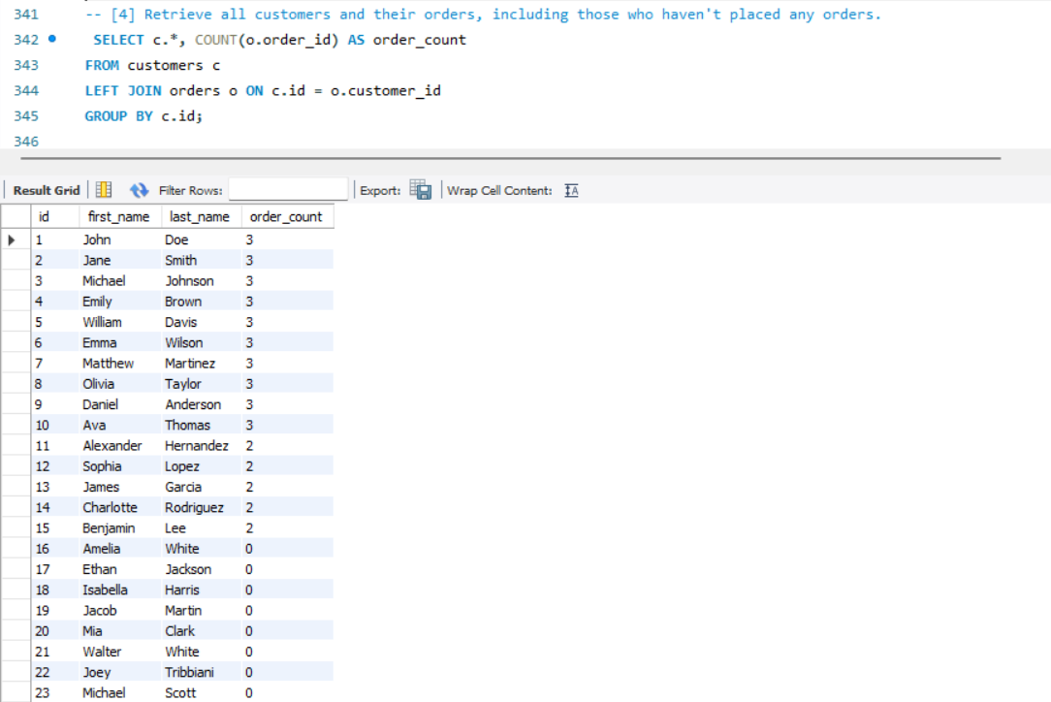
Joins
Retrieve all customers and their orders, including those who haven't placed any orders.
Syntax:
SELECT c.*, COUNT(o.order_id) AS order_count FROM customers c LEFT JOIN orders o ON c.id = o.customer_id GROUP BY c.id;

Slide 25
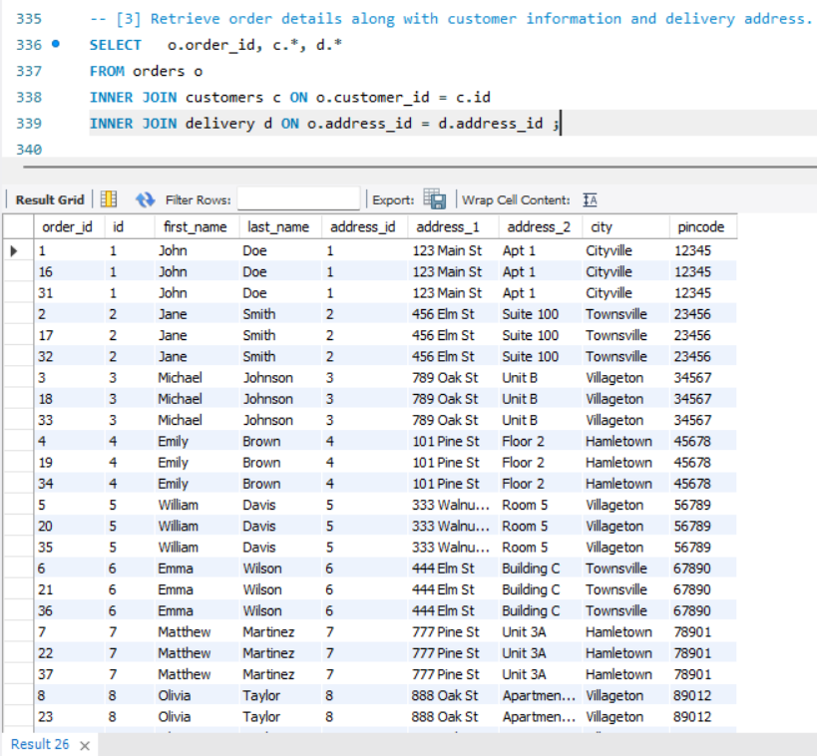
Joins
Retrieve order details along with customer information and delivery address.
Syntax:
SELECT o.order_id, c.*, d.* FROM orders o INNER JOIN customers c ON o.customer_id = c.id INNER JOIN delivery d ON o.address_id = d.address_id ;

Slide 26
Conclusion
Bens’ Pizzeria SQL project successfully demonstrated the capabilities of SQL in creating and managing a complex database system for a pizza business.
The SQL project was an endeavor aimed at creating a robust and efficient database system to manage various aspects of a pizza business, including customer orders, their addresses and inventory.
This project provided valuable insights into the complexities of database design and management, and showcased the power of SQL for handling large datasets and performing complex queries.
Analytical queries were developed to generate reports on various business metrics, such as daily sales, per person order, etc.

Slide 27
Thank You !!
Prepared By
Darshan Pawar
ITVEDANT
(T313 - PS – 11to1)

